Slide 1
Monthly meeting
Our Activity & our development area

Slide 2
Team Playerment & team motivation (Channel Partner, DSR, Retailers, Retailers key sales person, SBC & Outer all stake holders)
Product Knowledge development
(Every Saturday DSR training or written examination)
Sales boost up Initiative, People engagement & Alignment
Heroism , be confident about you. Terminate inadequately sales people from your team.
Be Target oriented (Tertiary, Secondary, Primary , All SKU Placement, ensure Smart phone placement )
Potential & Plug

Slide 3
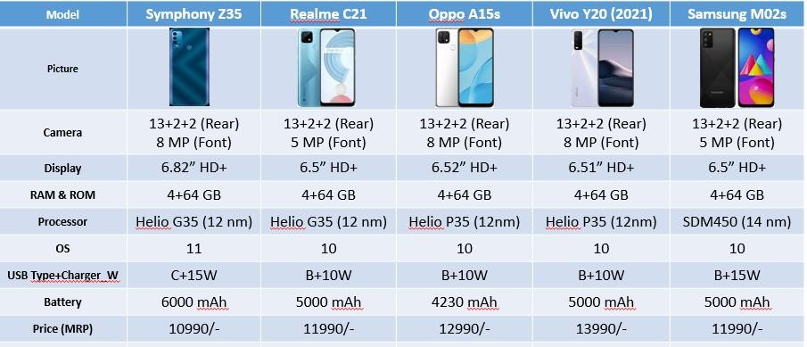
Spec Comparison of Z35 & others
Remark: Z35 Excellent product in term of highest Display size, Excellent on Processor, OS 11, 15W fast charging, 6000mAh big battery & aggressive price.

Slide 4





Price range wise Spec comparison ( 7500 - 9000 BDT)
Specification | Realme C20a | Tecno Spark 6 GO | Samsung M01 | Vivo Y1s | Atom 2 | Symphony Z18 | Symphony Z32
Handset photo
Current Price (CP) | 8990/- | 8690/- | 7999/- Exchange | 8990/- | 7790/- | 7990/- | 8790/-
Launching Date | Jul-20 | October 2020 | Sep’-20 | March-21 | June 2021 | January 2020 | March 2021
Operating System | Android 10, realme UI 1.0 | Android 10 Go (HiOS 6.2) | Android 10 (Go edition) | Android 10 | Android 10 (Go Edition) | Android 10 | Android 10
Processor & Brand Name | Octa-core 2.3 GHz | Quad-core, 1.8 GHz | Quad-core 1.5 GHz | Octa core, up to 2.35 GHz | Octa-core, 1.8 GHz | Octa-core, 1.8 GHz | Octa-core, 1.8 GHz
Chipset | MediaTek Helio G35 (12 nm) | Mediatek Helio A20 (12 nm) | Mediatek MT6739 (28 nm) | Mediatek Helio P35 (12 nm) | Unisoc | Unisoc | Unisoc
Memory | 2GB+32GB | 2GB + 32GB | 2GB+32GB | 2GB+32GB | 2GB+32GB | 2GB+32GB | 3GB+32GB
Display | 6.5'' HD+ IPS (270 PPI) | 6.52’’ v notch IPS 269 PPI, | 5.3’’ PLS TFT HD+ | 6.22’’ HD+ IPS notch,270ppi | 6.52’’HD+ 269 PPI notch | 6.52’’ HD+ IPS 269PPI | 6.52’’ HD+ IPS 269PPI
Camera | 8MP + 5MP | 13MP + AI & 8MP DUAL flash light | 8MP+5MP | 13MP+5MP | Dual 8+0.08 Megapixel & front 8MP | 13MP+2MP & 5MP | 13MP+2MP & 5MP
Battery | 5000 mAh | 5000mAh | 3000mAh | 4030 mAh | 4000mAh | 5000mAh | 5000mAh
Thickness | 9.1mm | 9.1mm | 8.6mm | 8.3mm | 8.4mm | 9.3mm | 9.3mm
Remarks:
From this segment priorities big battery & cheap price compare Tecno, Vivo, Realmi to introduce Z Series & ATOM
Symphony only provide Octacore Processor below 8K with big battery or exclusive design like Z18 & Atom 2
Symphony Only Provide 3GB RAM product below 9K in device industry

Slide 5



Thank You!

